Slide 1
Health Production Functions

Slide 2
Measures of Health Status
What do we want:
A measure of the population’s health status, that captures those aspects of health that are meaningful, and can be measured with accuracy (i.e., quantifiable).
Two main types: mortality and morbidity.

Slide 3
Measures of Health Status:
Mortality Measures
Popular measures because is easy to quantify
  know when someone dies and is regularly recorded information
Crude death rate
  number of deaths per 100,000 population
  for some time period—usually a year

Slide 4
Measures of Health Status:
Mortality Measures
Infant mortality rate:
  Number of death of children < age 1 per 1000 live births
  Adjust for age, sex, and race to make more meaningful
  Not necessary accurate in low-income and war-torn places
Under-five mortality rate
Mortality rate for elderly

Slide 5
Measures of Health Status:
Mortality Measures
Life expectancy at birth (male and female)
Cause of death
  In more developed countries, can use the cause of death to make analysis more meaningful
  i.e., if studying pollution, may want to look at deaths due to asthma, or respiratory infections for infants (< age 1) or small children (< age 5)

Slide 6
Measures of Health
Mortality Measures: Problems
Problems with mortality measures
  Give information on acute problems that lead to death but don’t provide information on quality of life (do you live in pain and can you perform the tasks you want)
  Tend to be used in aggregate data analysis not individual analysis

Slide 7
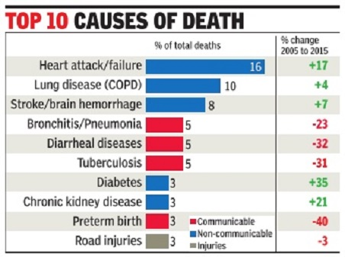
The ten top causes of death in India, 2005-15

Slide 8
Measures of Health
Morbidity
Morbidity: A statement about the extent of disability a person suffers as a consequence of a disease over time.
Difficult to quantify because no clear end point and need to asses: duration, severity, and consequences of a disease.

Slide 9
Measures of Health
Morbidity
Need to measure the disability which could be physical, mental, functional, or social.
Some sources of these types of data are:
  Hospital inpatient discharge records.
  Hospital outpatient discharge records / outpatient records.
  Survey data: self health assessments, days lost from work.

Slide 10
Measures of Health
Morbidity
Typical morbidity measures includes:
  Restricted-activity days due to illness
    e.g. number of working days lost
  Incidence rate of certain chronic conditions.
  Self-assessment of health status.
  Measures of mobility or activity (ADLs–activities of daily living).
  Biomarkers: a characteristic that is objectively measured and evaluated as an indicator or normal biologic process. For example: blood pressure, cortisol (stress measure).

Slide 11
Health Production Functions
Health Production Function: describes the relationship or flows of inputs and flows of outputs over a specified period.
Where output is usual some measure of health status (HS).
HS=F(inputs to health)
What could the inputs be?
HS=F(health care, environment, education, lifestyle, genetic factors, income)

Slide 12
Health Production Functions
Health Status (HS)
Does it make sense the curve flattens out, should it bend downwards again?
B
A
A>B : as you increase the number of health care inputs, the effects on total health status decrease.
1
2
3
4
5
6
Health Care Inputs (HI)

Slide 13
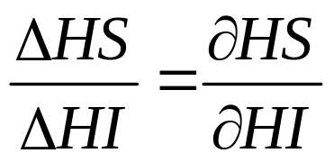
Marginal Product of Health Care
Marginal Product of Health Care
Marginal Product: Is the increment in health status caused by one extra unit of Health Care, holding all other inputs constant?
A
MP is diminishing in size, demonstrating the law of diminishing marginal returns.
B
1
2
3
4
5
Health Care Inputs

Slide 14
Marginal Product of Health Care
Marginal product that is relevant for policy makers:
  They want to know if I add one billion dollars to health care, how much will the health status of the population improve.
The marginal product might be different for different types of groups, such as young, elderly, or poor.

Slide 15
Determinants of Health
Historical View
To know what factors go into the health production function (inputs) need to understand the determinants of health.
Historical Question: what led to the population explosion and increase in life expectancy?

Slide 16
Why has mortality declined?
Big medicine theory
  Antibiotics for infectious diseases
  High-tech treatments for cardiovascular disease
Economic growth theory
  Nutrition allows one to withstand disease
Public health theory
  Better sewers, cleaner water and air
The long reach of early life factors
  Maternal nutrition in utero and fetal development
  What looks like big medicine now could be long-term effects of better nutrition, public health in the past

Slide 17
Big Medicine
Medicine is often a starting point
  Seems logical?
Many studies show effects of medicine for specific conditions
  Drug trials
  Cardiovascular care
  Small pox!
  Some better than others
Difficult to assign an overall contribution
Readings question role of Big Medicine

Slide 18
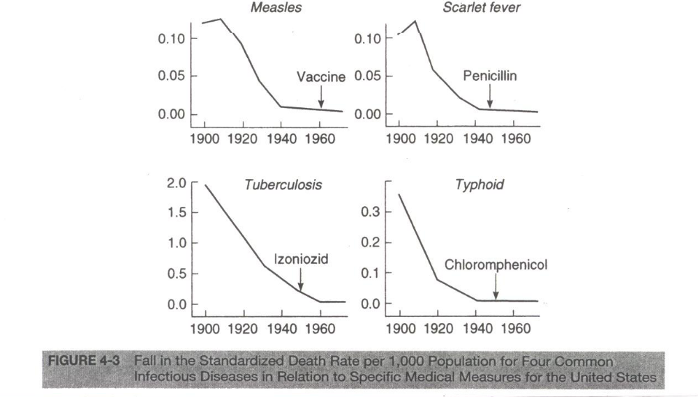
Big Medicine

Slide 19
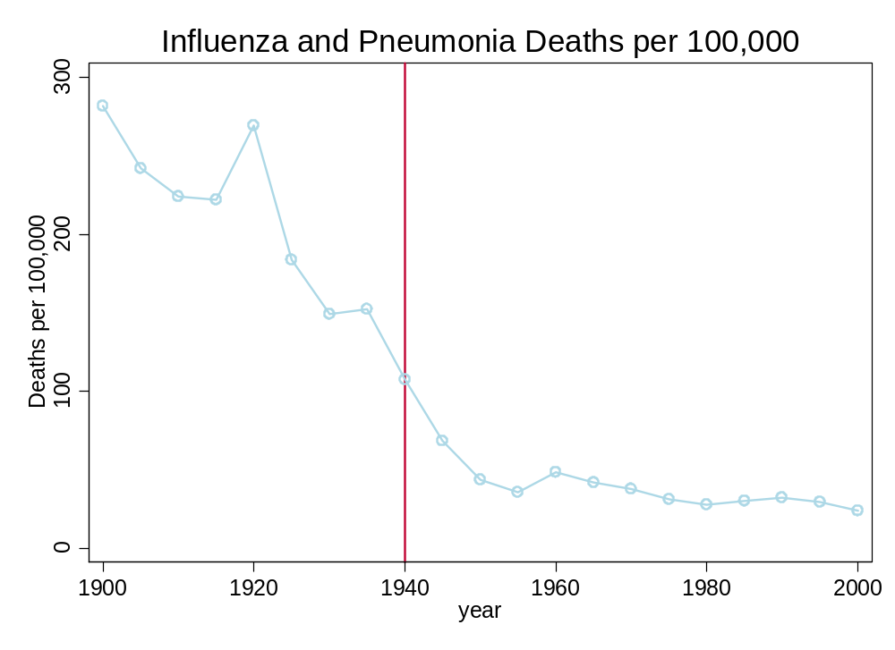
Big Medicine:Antiobiotics
The development of antibiotics helped, but it came very late in the process.

Slide 20
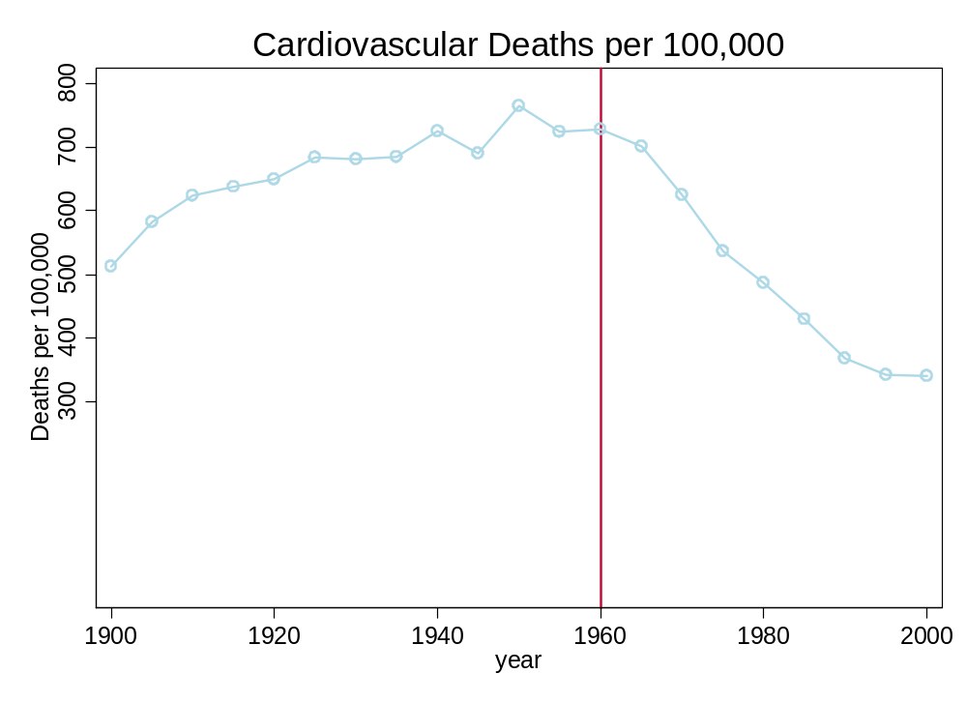
Big Medicine: Cardiovascular Disease
Medical advance appears more important for cardiovascular disease.

Slide 21
Economic growth & nutrition
Fogel: Find direct evidence for economic growth hypothesis
Measures of nutrition:
  Height (nutrition as a child, esp. up to age 3)
  Weight (nutrition as an adult)
Finds
  Taller people live longer
  People at the appropriate weight live longer
Collected lots of data on weights and heights over time

Slide 22
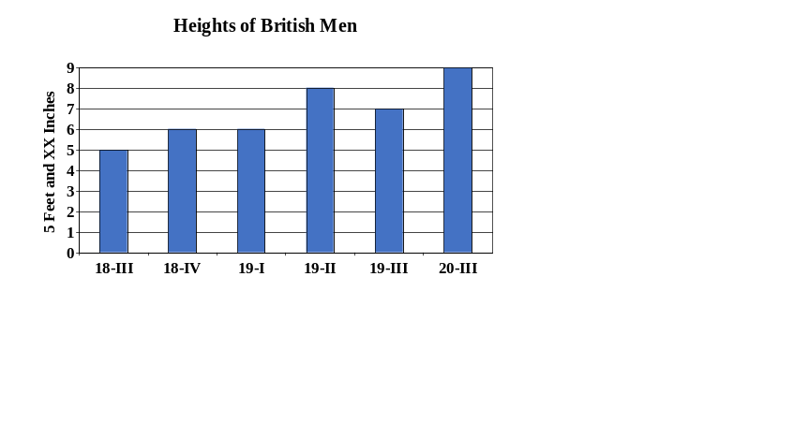
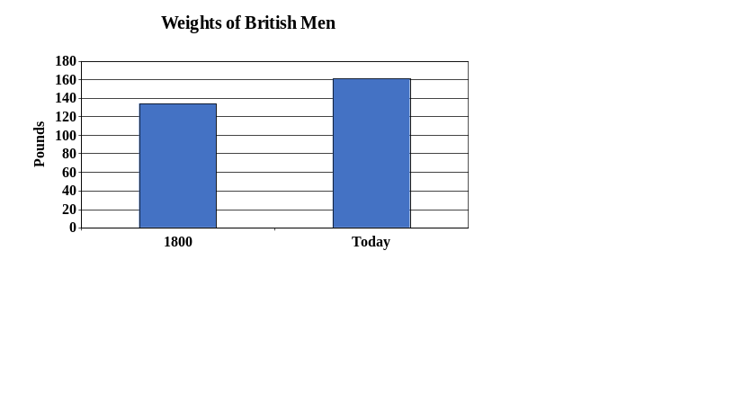
Economic Growth Explanation
In 1800, people were shorter and below optimal weight given height.
Both heights and weights have increased over time.
Fogel: This explains 50 to 80 percent of mortality decline.

Slide 23
Economic Growth Explanation
This was a time of exploration and many new foods were introduced into people diets.
Agriculture was advancing, new crops, crop rotation, seed production ….
Standards of living were increasing as a result of trade so people had the money to buy more food.
Better nutrition results in stronger immune system

Slide 24
Public Health Explanation
Preston and Deaton response to Fogel:
  Fogel presents evidence on nutritional status not availability
    Economic growth not only factor in nutrition
    Interaction between disease and caloric intake
  By 1900, U.S. well-fed → improvement since then?
  Relationship between income and health changing
    Example: China is about as rich as the US in 1900, but has life expectancy fairly close to US today and far above US in 1900
    Quality of the food matters

Slide 25
The Public Health Revolution
Modern health practices date from the early 20th century (post germ theory)
  Macro public health: sanitation; clean water; pasteurized milk
  Micro public health: bathing and hand washing
Epidemiological studies: specific public health interventions improve health
Gap in child mortality by class emerges after public health information is available
  Upper classes had more information?

Slide 26
The Public Health Revolution
First epidemiological study in public health
1854 and John Snow Cholera outbreak
  Sept 1854, 600 people living with a few blocks died of cholera. (thought a low lying cloud caused cholera)
  Obtain water by signing up with a water supply company. (there were a couple of companies in area)
  One company moved to a less polluted part of Thames–deaths much lower for HH receiving this water.
  Matter of public health to make sure water coming from clean areas or to chlorinate the water.

Slide 27
The Long Reach of Early Life
Are recent mortality reductions due to public health or nutrition changes long ago?
  Maybe there is much more to play out?
Almond and Mazumder: Effects of in utero exposure to flu
  Substantial long-term effects of exposure to flu in utero during 1918 flu pandemic
Do other early life factors matter, but less dramatically?

Slide 28
Why has health improved?
Probably all three mattered
Contributions differ by time period
Economic development/nutrition
  Most important before c. 1880
Public health/germ theory
  Most important c. 1880-1960
Improved medical care (Big Medicine)
  Most important since 1960

